Slide 1
Units 1.1-1.6
1.1 | Introduction to Algorithms, Programming, and Compilers
1.2 | Variables and Data Types
1.3 | Expressions and Output
1.4 | Assignment Statements and Input
1.5 | Casting and Range of Variables
1.6 | Compound Assignment Operators
AP CS A
Ms. Baniqued

Slide 2
Creating Output
Print and Wait vs. Print and Advance
System.out.print vs. System.out.println
String name = “Paola”;
double balance = 213.33;
System.out.println(name + “, your balance is $” + balance + “.”);
OUTPUT: Paola, your balance is $213.33.
When used with String types, the + operator is the concatenation operator. When used with numeric values, it is the addition operator.
Code Demo: DemoUnit1.java
Notes:
CODE DEMO DemoUnit1.java

Slide 3
Java’s Compiler + Interpreter
Editor
Compiler
:
:
7


K
Hello.java
Hello.class

Interpreter
Interpreter


Hello,
World!
Hello,
World!
Copyright © 2015 by Maria Litvin, Gary Litvin, and Skylight Publishing. All rights reserved.

Slide 4
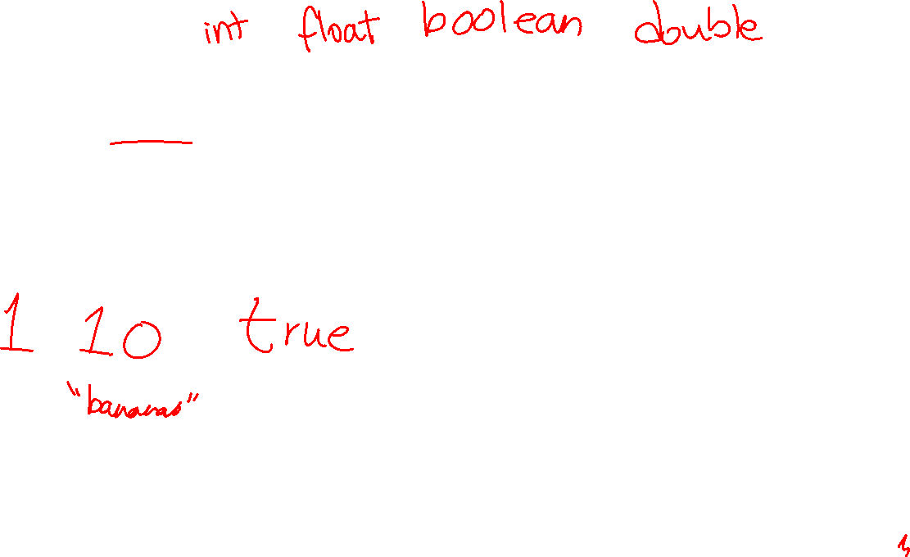
Primitive Data Types
In Java, all literals have an associated data type. The data type of a literal determines how that value can be used in the code segment.
Literals represent constant values in the code segment that cannot be changed during the program’s execution.
What are some examples of literals?
Code Demo: PrimitiveDataTypes.java
Notes:
CODE DEMO PrimitiveDataTypes.java

Slide 5
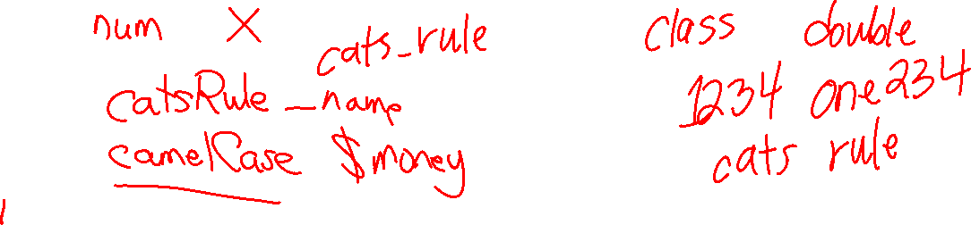
Variables in Java
In Java, a variable is a named memory location that stores a value of a particular data type. Variables are used to store values that can be accessed and manipulated throughout a program.
A variable can hold different values throughout the execution of a program. Each variable has a name (aka identifier) and is associated with a set data type that determines what kind of values it can store.
What are some valid variable names?
What are some invalid variable names?

Slide 6
Variables Naming Rules in Java
A variable name is a user-defined identifier in Java. All identifiers as case-sensitive. To create a user-identifier, the following conditions must be met:
The identifier must start with a letter, a dollar sign ($), or an underscore (_)
Can be followed by letters, digits, dollar signs, or underscores
Cannot be Java keywords or reserved words (Litvin p50)
By style convention, non-final variable names should be typed in camelCase (First world is lowercase, following words have the first letter capitalized)
To increase code legibility, variable names should be meaningful and relevant.

Slide 7
There are three types of variables in Java. For now, we will focus on declaring and initializing local variables.
Declaring a variable means that you are creating a named space in memory to store a value of a certain type.
Initializing a variable means that you are assigning an initial value to that variable. A variable must be initialized before it can be accessed in a class.
To declare a variable in Java, you must specify its data type followed by its name/identifier. You can optionally assign an initial value to the variable when the variable is declared. A local variable cannot be used in a code segment until it has been assigned an initial variable.
dataType variableName1; // declared, not initialized. Cannot be used in a code // segment yet
variableName1 = <some value>; // initialized. Able to use in a code segment
dataType variableName2 = <some value>; // declared and initialized all at once

Slide 8
Primitive Types and Reference Types
Primitive Data Types
byte, short, int, long, double, float, boolean
Reference Types (Objects)
String, Scanner, Color, Fruit, Integer, Boolean
How different types are stored in memory (Java)
All data for primitive type variables is stored on the stack
For reference types, the stack holds a pointer to the object on the heap
When setting a reference type variable equal to another reference type variable, a copy of only the pointer is made
Certain object types cannot be manipulated on the heap (immutable objects)

Slide 9
Java’s Stack and Heap
Java Code
Stack
Heap

Slide 10

Java’s Stack and Heap
int a = 3;
Java Code
Stack
Heap

Slide 11
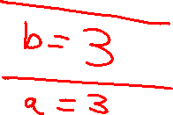
Java’s Stack and Heap
int a = 3;
int b = a;
Java Code
Stack
Heap

Slide 12
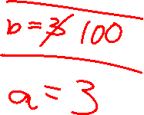
Java’s Stack and Heap
int a = 3;
int b = a;
b = 100;
Java Code
Stack
Heap

Slide 13
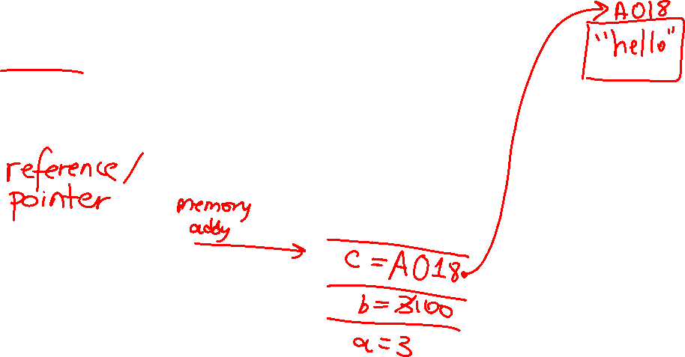
Java’s Stack and Heap
int a = 3;
int b = a;
b = 100;
String c = “hello”;
Java Code
Stack
Heap

Slide 14
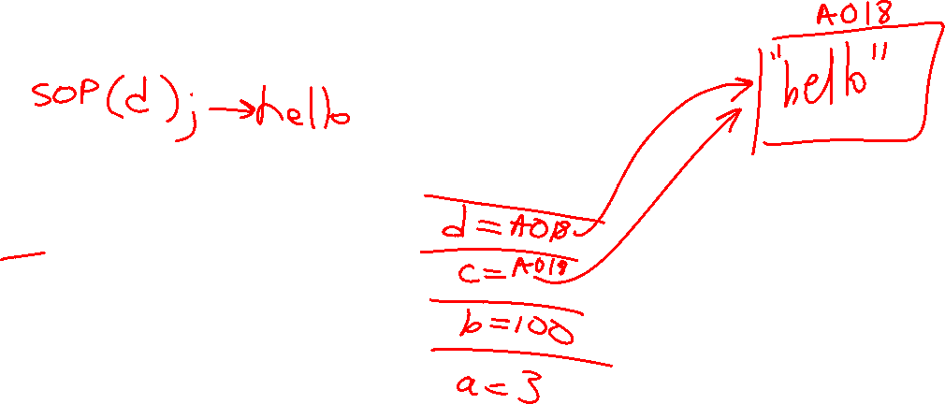
Java’s Stack and Heap
int a = 3;
int b = a;
b = 100;
String c = “hello”;
String d = c;
Java Code
Stack
Heap

Slide 15
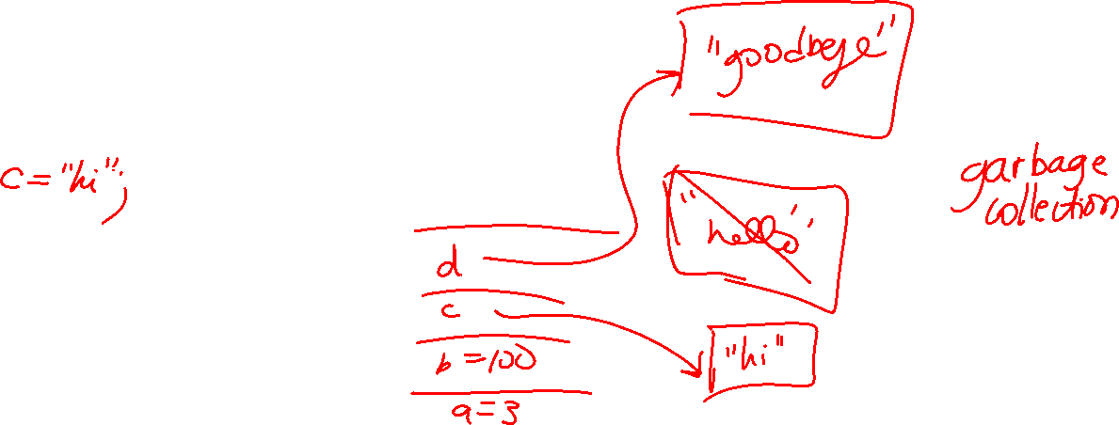
Java’s Stack and Heap
int a = 3;
int b = a;
b = 100;
String c = “hello”;
String d = c;
d = “goodbye”;
Java Code
Stack
Heap

Slide 16
Java’s Stack and Heap
int a = 3;
int b = a;
b = 100;
String c = “hello”;
String d = c;
d = “goodbye”;
Java Code
Stack
Heap

Slide 17
Unit 1 Terms
Literals
Declaring and Initializing Variables
Primitive Types
Reference Types
Compiler
Identifier
Java reserved word or keyword
Pointer
Stack
Heap
Immutable
Print and Wait
Print and Advance
Arguments
Concatenate

Slide 18
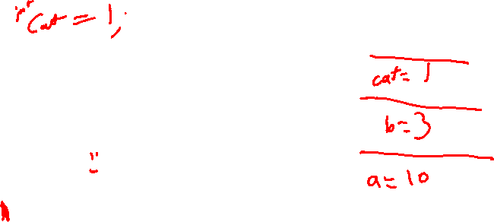
Java’s Stack and Heap
int a = 10;
int b = 3;
Java Code
Stack
Heap

Slide 19
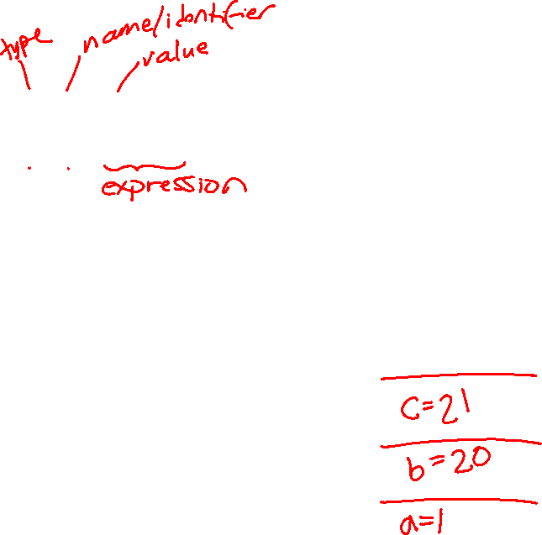
Java’s Stack and Heap
int a = 1;
int b = 20;
int c = a + b;
Java Code
Stack
Heap

Slide 20
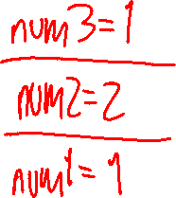
Java’s Stack and Heap
int num1 = 1;
int num2 = 2;
int num3 = num1;
Java Code
Stack
Heap

Slide 21


Java’s Stack and Heap
// provide the code that matches // with the data storage
Java Code
Stack
Heap

Slide 22

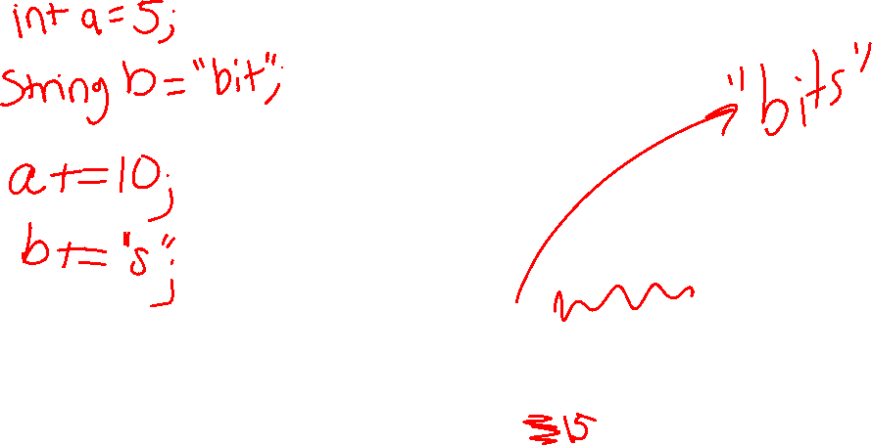
Java’s Stack and Heap
// provide the code that matches // with the data storage
Java Code
Stack
Heap

Slide 23
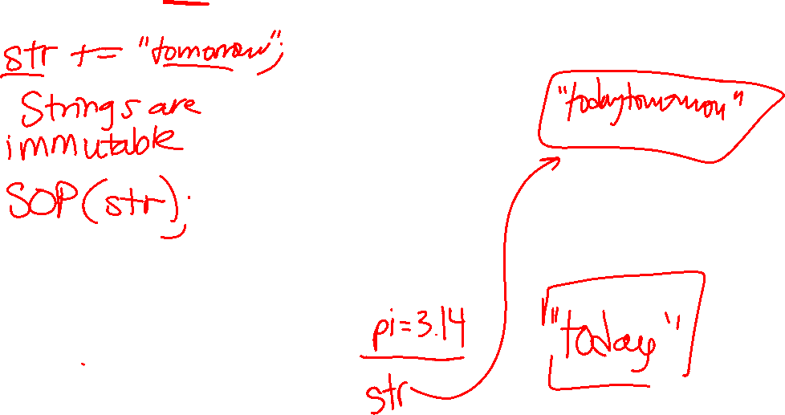
Java’s Stack and Heap
String str = “today”;
double pi = 3.14;
Java Code
Stack
Heap

Slide 24
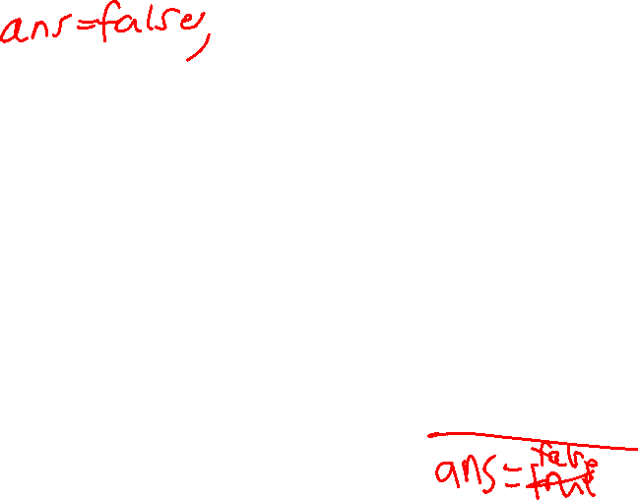
Java’s Stack and Heap
boolean ans = true;
Java Code
Stack
Heap

Slide 25
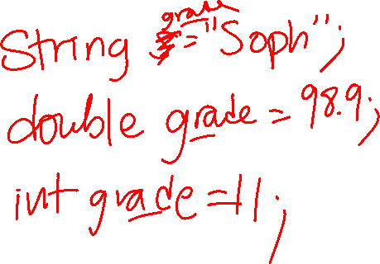
Declare a variable of type int named num.
Declare a variable named grade to store a student’s grade. Choose any data type.

Slide 26
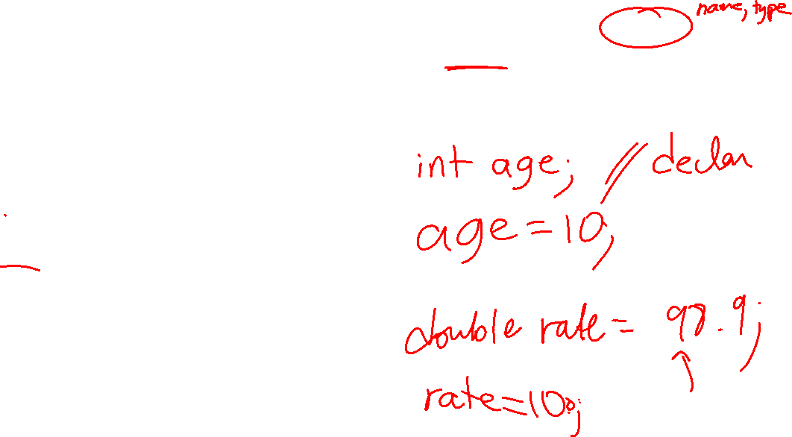
In a different way, declare and initialize a variable of type double named rate. You can choose the value.
Declare and initialize a variable of type double named rate. You can choose the value.

Slide 27
Declare and initialize a variable of type boolean that stores true if it is a B day, false otherwise. You should choose the identifier.
Declare and initialize a String called name. Use your name as the initial value.

Slide 28

Java Expressions and Assignment Statements
In Java, an expression is a combination of variables, literals, operators, and method calls that, when evaluated, result in a single value.
Assignment statements are used to assign a value to a variable using the assignment operator (=).
/* When assigning a value to a variable, the variable is on the left side of the assignment operator, and the value assigned to the variable is on the right side. */
// This code assigns the value 10 to the variable x int x = 10;
/* The value assigned to a variable can be a literal, a variable, a method or constructor call, or an expression */
String result = “x times 2 is: “ + (2 * x); // evals to a single String value

Slide 29
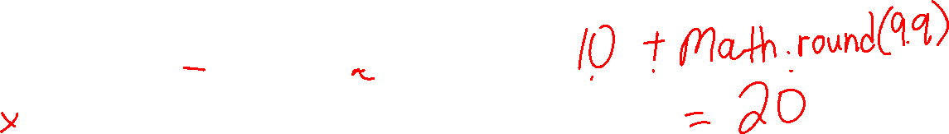
Identifying method calls
We aren’t learning about methods yet, but you can identify a method call by its argument list, denoted by a pair of parentheses (). A method can have no arguments or it can have up to 255 arguments.
// examples of method calls stored in variables
String name = s.generateName(5);
int count = countOccurences(”A”, true) + 10;
TicketMachine ticket1 = new TicketMachine(25);
int machineProceeds = ticket1.emptyMachine();
// storing the int result of an arithmetic expression in sum
int grade1, grade2, grade3;
int sum = grade1 + grade2 + grade3; // this code throws an error. Why?

Slide 30

Java Arithmetic Expressions
Java arithmetic expressions are written the same way as in algebra and may include literal and symbolic constants, variables, the arithmetic operators +, -, *, /, %, and parentheses.
The order of operations is determined by PEMDAS.
Note: Unlike algebra, multiplication in Java requires the * sign – it cannot be omitted.
You can also use the minus symbol for negation. For example:
x = -(y + 2*z) / 5;
a = -a;
Java also has the modulus operator % for integers.

Slide 31
Explaining Modulus
a % b is read “a modulus b” or “a mod b”. Modulus has the same rank as division and multiplication.
The result of a % b is the remainder when a is divided by b.
ex. 31 % 7 = 3
The modulus operator is commonly used to check if a number is divisible by another. For example:
if (k % 2 == 0) ... //if k is even...
It also comes in handy for computing values that change in a cyclical manner.
int minsAfterHours = totalMins % 60;
int lastDigitBase10 = x % 10;
Notes:
Code Demo

Slide 32
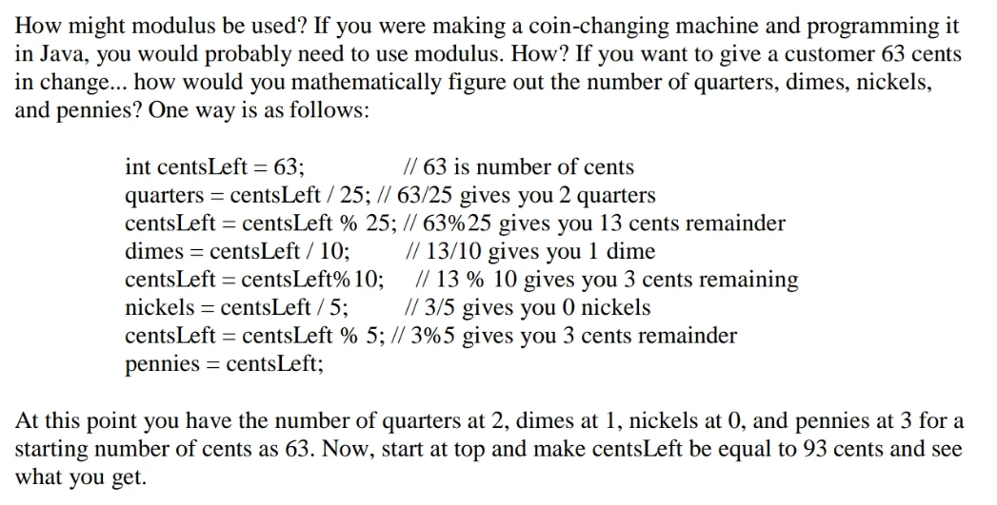
Modulus Example:
Notes:
From Learning Java through Alice 3 (Daly, Wrigley)

Slide 33
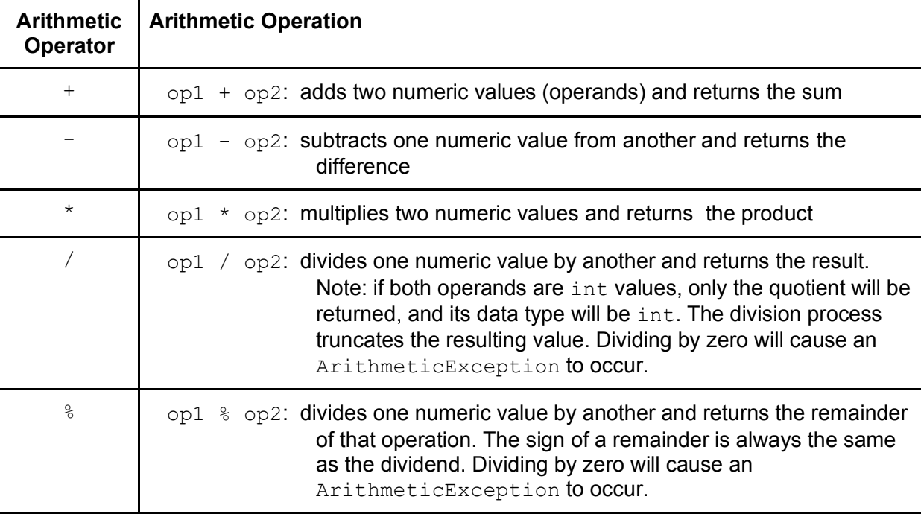
Java Arithmetic Operators

Slide 34
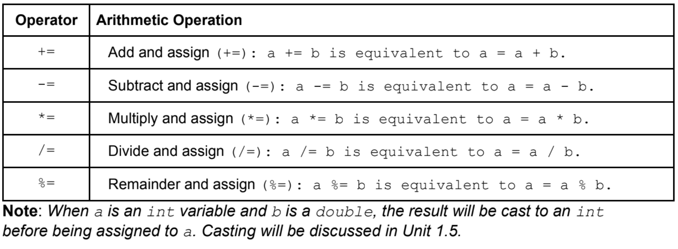

Java Compound Assignment Operators
Compound assignment operators perform an arithmetic operation and an assignment operation in a single statement. They are used to simplify and shorten the code when you need to perform an arithmetic operation on a variable and then store the result back into the same variable.

Slide 35
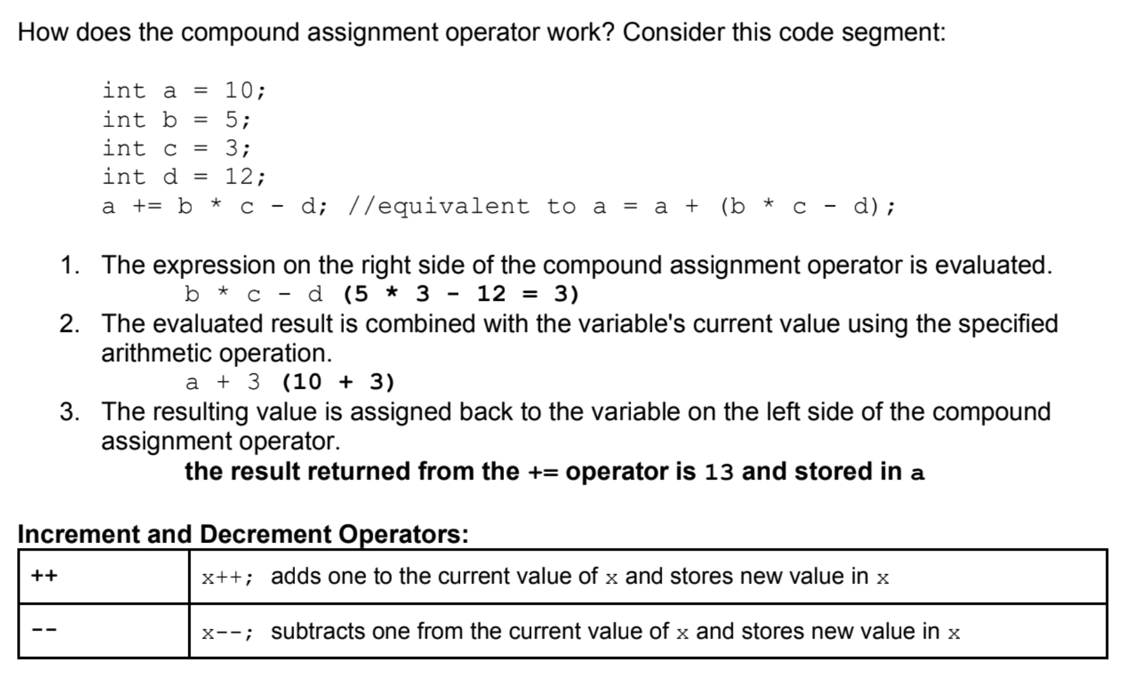
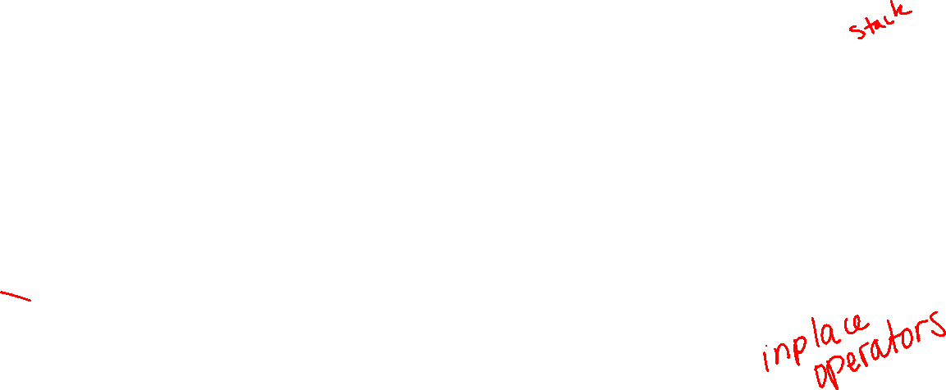
Java Compound Assignment Operators

Slide 36
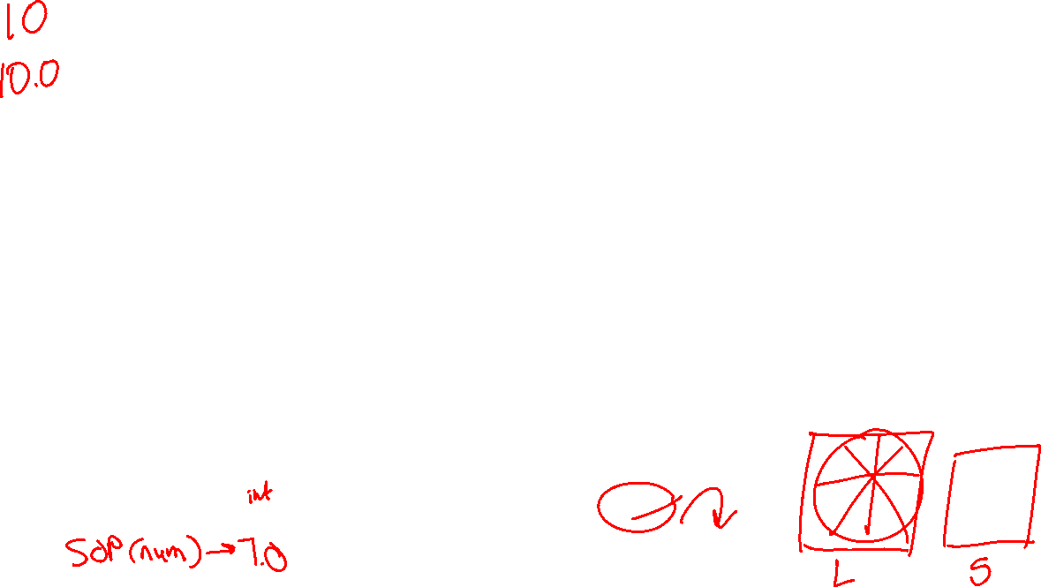
Casting and Ranges of Variables
In Java, casting refers to the process of converting a value from one data type to another. When working with primitive data types, casting can convert a value to a different data type if the two data types are compatible.
Explicit Casting
This is required when the source type has a larger range than the target type, which means that data loss might occur. In this case, the the programmer must explicitly specify the desired data type using a cast operator. This is done by placing the target data type in parentheses before the value to be cast. Ex. double pi = 3.14; int castPi = (int) pi;
Implicit Casting or Widening
This happens automatically when the source type has a smaller range than the target type. Ex. Assigning an int value (smaller) to a double variable (larger) double num = 7;

Slide 37
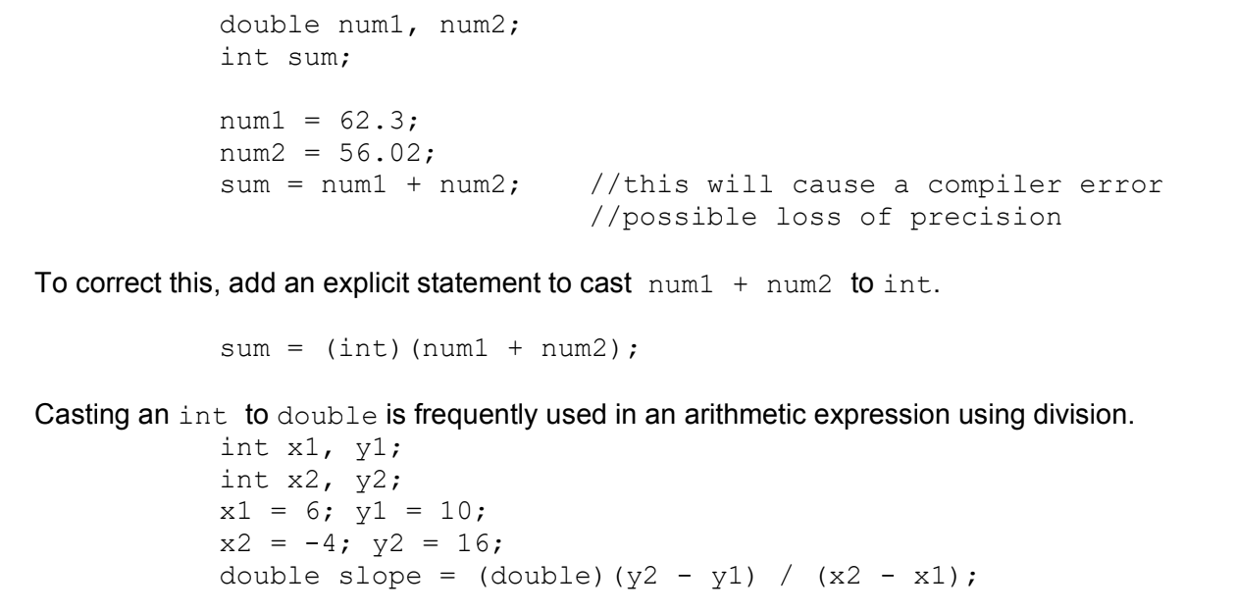

Casting and Ranges of Variables
Explicit Casting Examples:

Slide 38
Ranges of Variables
Explicit Casting Examples:

Slide 39
Unit 1 Terms (cont.)
Assignment Operator
Compound Assignment Operator
Increment and Decrement
Modulus
Integer Division
Negation
Expression
Method Call
Cast Operator
Implicit Casting/Widening
Explicit Casting

Slide 40
Units 1.7-1.15
1.9 | Method Signatures
1.10 | Calling Class Methods
1.11 | Math Class
1.12 | Objects: Instance of Classes
1.13 | Object Creation and Storage (Instantiation)
1.14 | Calling Instance Methods
1.15 | String Manipulation
AP CS A
Ms. Baniqued

Slide 41


What is a method?
A method is a set of instructions that can be used upon request.
The main method is generally a starting point of all Java application programs. When you run your program, the main method is called by default.
Some methods have parameters, or arguments, special variables that receive information that we pass, or send to a method. Parameters give programmers choices when using methods.
When you use a method, we refer to it as calling or invoking a method.
Method
Argument(s)
Method Call

Slide 42
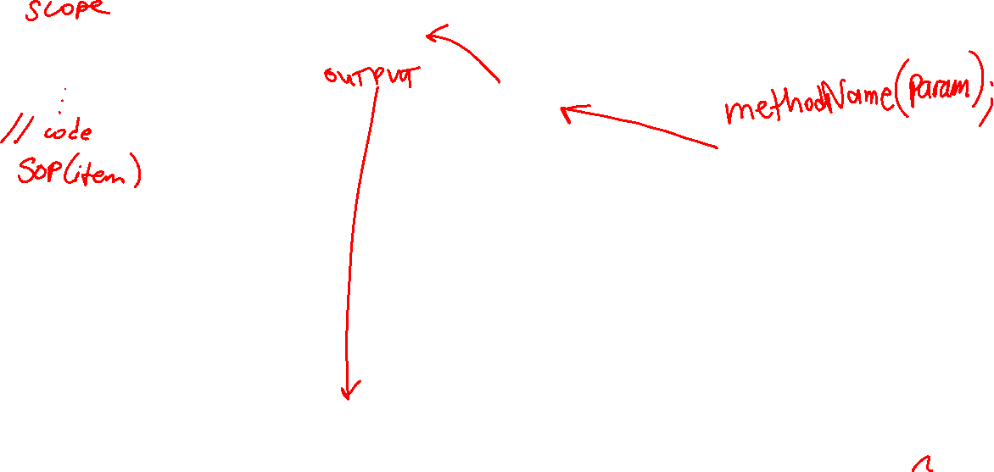
Method example:
public static void throw(String item) {
System.out.println(“He threw a ” + item);
}
“ball”
throw(“ball”);
Console Output: He threw a ball

Slide 43

What if we change the argument?
public static void throw(String item) {
System.out.println(“He threw a ” + item);
}
“bell”
throw(“bell”)
Console Output: He threw a bell

Slide 44
Procedural vs. Functional Methods
A procedural method does not return a value. A functional method does. You can think of a procedural method as a command, and a functional method as an answer to a question.
To “return a value” means to give back a result. If I “tell” a procedural method to do something, it will do it. If I “ask” a functional method to do something, it will give me the finished product.
Procedural methods have a return type of void. Procedural methods will not return a value, but these methods can:
Print output to the console
Modify a ‘global’ value, a variable that exists outside of the method
Call another method
Functional Methods can have a return type such as int, double, String, etc. You can assign a functional method call to a variable.
Example:
String name = generateName(10); //generates a random name of length 10

Slide 45
Method Signature “Template”
modifier static return-type methodName(list of parameters) { … }
modifier - public or private
static - means the method is not associated with an object…we’ll get back to this later)
return-type – can be void, a primitive data type, or an Object type such as String)
methodName - follows the same guidelines as variable names)
list of parameters – a list of all the data you will be sending into the method (can be empty)

Slide 46
Java Built-In Methods (String Methods)
For Java Built-In Methods, we do not have to write the code for these methods, nor do we need to access/import another library or class.
Method Header | Description
int length() | Returns the number of characters in a String object.
boolean equals(String other) | Returns true if this String is equal to the String referenced by the parameter other, false otherwise.
String substring(int from) | Returns the substring beginning at index from and ending at index to - 1.0 <= from <= to <= length()
String substring(int from, int to) | Returns the substring beginning at from and ending at length() – 1. Equivalent to substring(from, length()). 0 <= from <= length()
int indexOf(String str) | Returns the index of the first occurrence of str or -1 if str is not found. The first character of a String is at index 0. The last character of a String is at length() - 1.
int compareTo(String other) | Returns: - a negative int if this String is less than other’s String - 0 if this String is equal to other’s String - a positive int if this String is greater than other’s String

Slide 47
String compareTo examples
String str1, str2; int result; //positive, negative, or zero
Example | Result
str1 = "same"; str2 = "same"; result = str1.compareTo(str2); | 0
str1 = "same"; str2 = "same"; result = str2.compareTo(str1); | 0
str1 = "apple"; str2 = "zebra"; result = str1.compareTo(str2); | negative (a < z)
str1 = "apple"; str2 = "zebra"; result = str2.compareTo(str1); | positive (z > a)
Example | Result
str1 = "apple"; str2 = "apply"; result = str1.compareTo(str2); | negative (e < y)
str1 = "apple"; str2 = "Apple"; result = str1.compareTo(str2); | positive (a > A)
str1 = "apple tree"; str2 = "apple"; result = str1.compareTo(str2); | positive

Slide 48
Using the Math Class
The Java Math class is a built-in class in the java.lang package that provides a collection of mathematical functions and constants.
* All of the Math class methods and constants are static, which means you can directly access them using the class name without creating an object. (Unlike the String methods).
Method Header | Description
static int abs(int x) | Returns the absolute value of x as an int
static double abs(double x) | Returns the absolute value of x as a double
static double pow(double base, double exponent) | Returns base^exponent
static double sqrt(double x) | Returns the square root of x
static int random() | Returns a double in the range [0.0, 1.0) From 0.0 up to but not including 1.0

Slide 49
Autoboxing and Unboxing (Wrapper Classes)
Primitive data types store only single values. Examples: 10, 22.5, true
Reference types store only references. Examples: String, Scanner, ArrayList
In Java, the wrapper classes, such as Integer and Double, are used to convert primitive types into reference types
Java 5.0 added autoboxing; autoboxing is accomplished without having to call a constructor or method of a corresponding object wrapper class.
Autoboxing is the automatic conversion that the Java compiler makes between primitive types and their corresponding object wrapper classes.
Unboxing in the automatic conversion that the Java compiler makes from the wrapper class to the primitive type.
Every primitive data type in Java has a corresponding wrapper class. AP CS A only tests you on Integer and Double.
Since Wrapper Classes are reference types, they are stored in the Java heap.

Slide 50
Review
Method
Procedural Method
Functional Method
Modifier
Return, Return Type
Parameter or Argument
Parameter List/Argument List
Built-in Methods
Math class methods
Java Expression
String Pool
Overloaded Method
String methods()
int length()
boolean equals(String other)
String substring(int from)
String substring(int from, int to)
int indexOf(String str)
int compareTo(String other)

Slide 51
So far, where have we heard the term ‘class’ or ‘object’?

Slide 52
So far, where have we heard the term ‘class’ or ‘object’?
Scanner class, Scanner object
String class, String object
Math class
Wrapper class
Class declaration
.class file
Based on our previous use, what would you say is the difference between a class and an object?

Slide 53
What is a Class?
A class is a piece of the program’s source code that describes a particular type of objects. A class is a fundamental building block of Object-Oriented Programming (OOP) and provides a way to encapsulate the state and behavior of an object.
In Java, a class serves as a blueprint or template for creating objects, which are instances of that class.
For example, a Car class contains the code that defines a Car’s data fields and methods (state and behavior). Several Car objects can represent different types of cars (cars with difference appearances or features/functions).

Slide 54
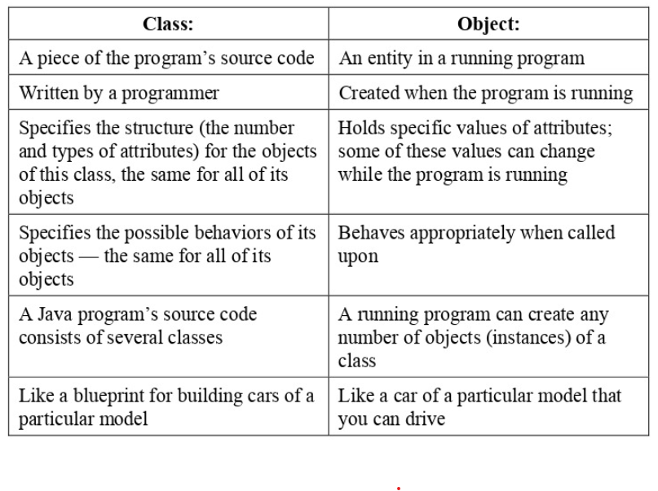
Class vs. Object

Slide 55
What is a class supposed to do?
A class name must match the name of the file (case sensitive). For example, a class Flower must be stored in a file named Flower.java.
In Java, a class describes 3 aspects that every instance (object) of this class has:
The data elements of an object of this class (These are called instance variables, fields, or attributes)
The ways in which an object of this class can be created (Procedures for creating an object are called constructors)
What this type of object can do (Methods)
Not every class has fields, constructors, and methods explicitly defined: some of these features might be implicit or absent.
VIEW CODE: Car.java and CarTest.java
Notes:
Open Car.java

Slide 56
Why use classes in Java?
Encapsulation: A class allows you to group related data (fields/attributes) and behavior (methods) together, which makes it easier to organize and maintain your code. Encapsulation promotes information hiding, meaning the internal state (attributes) of an object is protected from outside manipulation, and access is only granted through public methods. Only you, the programmer of Car.java, can define what a Car is or not.
Abstraction: By encapsulating the data and behaviors of an object, a class allows you to abstract away the complexity of the object by providing a simple interact to interact with. When you write code with classes, you can create objects that represent higher-level concepts in code, hiding the low-level implementation details.

Slide 57
Fields (Instance Variables or Attributes)
Instance variables are also called data fields, or fields, coming from the analogy with fields in a form that can be filled in with different values.
A field follows the format:
modifier data-type identifier;
Each field has a name, given by a programmer, and a type. For example, our Car class has 4 fields:
private String make; private String model; private int year; private double mileage;
In AP CS A, fields should always be private.

Slide 58
Fields (Instance Variables or Attributes)
Fields are never initialized when they are declared at the top of the class. They are always initialized in a constructor or another class method.
Unlike local variables, instance variables are given the zero-value as a default value when they are declared.
private String make; // default value null private String model; // default value null private int year; // default value 0 private double mileage; // default value 0.0
// boolean default is false
// char default is '\u0000’ which represents null
null is a reserved word (keyword) in Java for literal values. It is just a value that shows that an object is referring to nothing. If a reference type is set to null, memory is not allocated on the heap.
Fields have a global scope, which means they can be accessed by the whole class.

Slide 59
Creating Objects using a Constructor Call
An object, or an instance of a class, is created with the new operator, which invokes (calls) one of the constructors defined in the object’s class.
To create an instance of the Car class, we can invoke its default, no-args constructor:
Car myCar = new Car();
A constructor must always have the same name as its class. A constructor can accept no parameters or any number of parameters, as long as a class has a constructor that matches the expected parameter list.
For example,
Car myCar = new Car(4, 5);
would be an invalid line of code, since our Car class does not have a Car(int, int) constructor.

Slide 60
Writing Constructors
A constructor header consists of:
The keyword public, which means that other class methods can use this class to create objects. Constructors are always public.
The name of the constructor, which is always the same name as the class.
The parameter list, a list of parameters that accept values from the constructor call. This can be empty.
Fields are never initialized when they are declared at the top of the class. They are always initialized in a constructor or another class method.
// Default no-args constructor public Car() { this.make = DEFAULT_STR; this.model = DEFAULT_STR; this.year = 0; this.mileage = 0; } // Constructor with 4 parameters, 1 for // each field public Car(String make, String model,
int year, double mileage) { this.make = make; this.model = model; this.year = year; this.mileage = mileage; }

Slide 61
Review
Constructor
Invoking or Calling a Constructor
new keyword
Instantiation
Abstraction
Fields/Attributes/Instance Variables
Global scope
Type signature/method signature/method header
Class
Object (or instance)
Class API
Object-Oriented Programming (OOP)

Slide 62
Java Arithmetic Practice

Slide 63
3 + 5 * 10

Slide 64
3 + 5 * 10
Ans: 53

Slide 65
(3 + 5) * 10

Slide 66
(3 + 5) * 10
Ans: 80

Slide 67
5 + 10 % 4

Slide 68
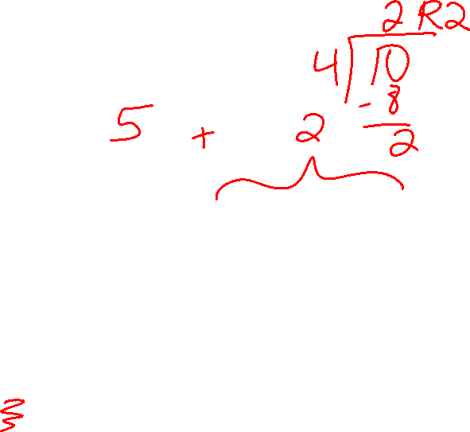
5 + 10 % 4
Ans: 7

Slide 69
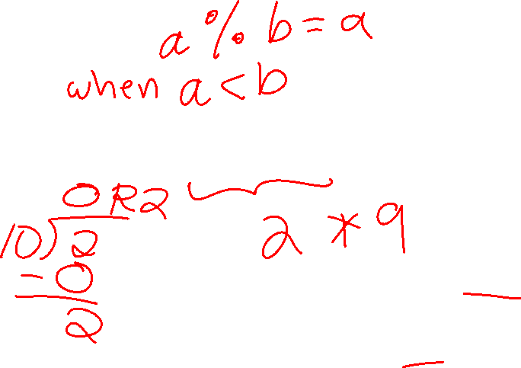
2 % 10 * 9

Slide 70
2 % 10 * 9
Ans: 18

Slide 71
(5 + 2 * 10) % 10

Slide 72
(5 + 2 * 10) % 10
Ans: 5

Slide 73
15 / 3 + (1 + 2) * 4

Slide 74
15 / 3 + (1 + 2) * 4
Ans: 17

Slide 75

int x = 5; x++;
What is x?

Slide 76
int x = 5; x++;
x is 6

Slide 77
int x = 5; x += 5;
What is x?

Slide 78
int x = 5; x += 5;
x is 10

Slide 79
int x = 4; int y = 2; x = x/y;
What is x?

Slide 80
int x = 4; int y = 2; x = x/y;
x is 2

Slide 81
int x = 5; int y = 2; x = x/y;
What is x?

Slide 82
int x = 5; int y = 2; x = x/y;
x is 2

Slide 83
int x = 3; int y = 3; x += y; x = 10;
What is x?

Slide 84
int x = 3; int y = 3; x += y; x = 10;
x is 10

Slide 85
int x = 3; int y = 3; int z = 10; x = x + y * z;
What is x?

Slide 86
int x = 3; int y = 3; int z = 10; x = x + y * z;
x is 33

Slide 87

int x = 3; x %= 2;
What is x?

Slide 88
int x = 3; x %= 2;
x is 1

Slide 89
Java Arithmetic Practice with doubles and casting

Slide 90
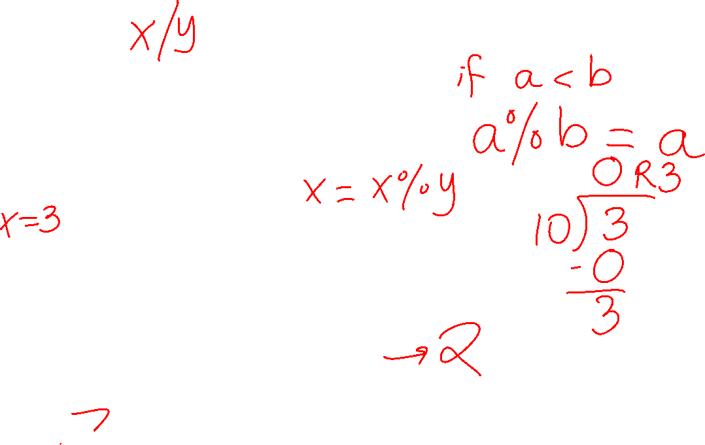
int x = 3; int y = 10; x %= y; x--;
What is x?

Slide 91
int x = 3; int y = 10; x %= y; x--;
x is 2

Slide 92

int x = 3; int y = 1; int z = 4; x = (x + y) % z + (x * y)
What is x?

Slide 93
int x = 3; int y = 1; int z = 4; x = (x + y) % z + (x * y)
x is 3

Slide 94
int x = 3; int y = 1; int z = 4; x = (x + y) % z + (x * y)
x is 3

Slide 95
double x = 3.0; double y = 10.0; x = x/y;
What is x?

Slide 96
double x = 3.0; double y = 10.0; x = x/y;
x is 0.3

Slide 97

double x = 5.6; double y = 2.1; int z = (int) x /(int) y;
What is z?

Slide 98
double x = 5.6; double y = 2.1; int z = (int) x /(int) y;
z is 2

Slide 99
double x = 5.6; int y = (int) x;
What is y?

Slide 100
double x = 5.6; int y = (int) x;
y is 5

Slide 101

int x = 7; int y = 10; double dbl = (double) x/y;
What is dbl?

Slide 102

int x = 7; int y = 10; double dbl = (double) x/y;
dbl is 0.7

Slide 103

int x = 10; double y = 4; double dbl = x/y;
What is dbl?

Slide 104
int x = 10; double y = 4; double dbl = x/y;
dbl is 2.5

